Slide 1


Catching ⬆️
The (Baseline) Unicode Plan for C++23
ThePhD | @thephantomderp | phdofthehouse@gmail.com
https://linkedin.com/in/thephd | https://thephd.github.io | https://github.com/ThePhD

Slide 2
In the Year 2019…
Unicode support in C and C++ is a grim tale
<cctype>
wstring_convert needed to be pulled for causing great harm to performance and more
Current conversion routines suck
Save a file in Germany with the default locale on Windows, ship it to Japan
Enjoy the hilarity

Slide 3

Pain Points
What makes encoding hard?

Slide 4
Pain: Various Flavors of Incompatibility
Compile time: “20 Å“
such literals may not compile cleanly on all platforms;
or, it compiles with only warnings and then mangles the data
Difficult to write programs which handle text portably at runtime
Locale-sensitivity creates enormous issues
Text written and serialized by iostreams in Czech republic does not read properly in Japan, or in the U.S., or…

Slide 5
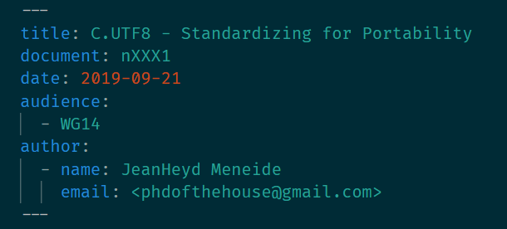
Fix: Change default C locale to be UTF8
“default”?
Yes – mandating is too strong
But, changing the default (with a way out) is more palatable
Encouragement from Axel Andrejs, Microsoft lead
Linux is already UTF8-by-default
Vastly improves sharing of default character handling of C programs
Do not expect overnight
6+ year process

Slide 6
☣️ Pain: Poisoned Input ☣️
Easy to end up with text nobody anticipated and encodings nobody knows
Encoding information is usually out-of-band (or non-existent)
Internal state thrown into chaos and unpredictability
Symptom: ad-hoc checks sprinkled throughout the codebase
Symptom: mojibake floating through the system at random points
Notes:
C spent a lot of time optimizing for achieving its local maxima
Multiple implementations specific to a single platform, sometimes a group of platforms
“Interwhat?” – code and program sharing was not at the scale we have now
C++ inherited a lot of this and has not really questioned it
minimum viable specification to work on an individual platform

Slide 7
Pain: Permeable Boundaries
Library/application author is internally consistent and aware of encoding
Still, receive text and did not know how to convert it properly
Ends up as mojibake, but is easier to find problems
[consistent utf-8] … [mostly]

Slide 8
Pain: Conversion Routines
C has insufficient to/from encoding schemes and is not extensible
Unicode support is limited to one-by-one code point conversion functions
Neither performant, nor helpful
What is the encoding of char and wchar_t ?
You don’t know, and it’s very hard to tell
Entirely platform specific, sometimes even architecture dependent

Slide 9
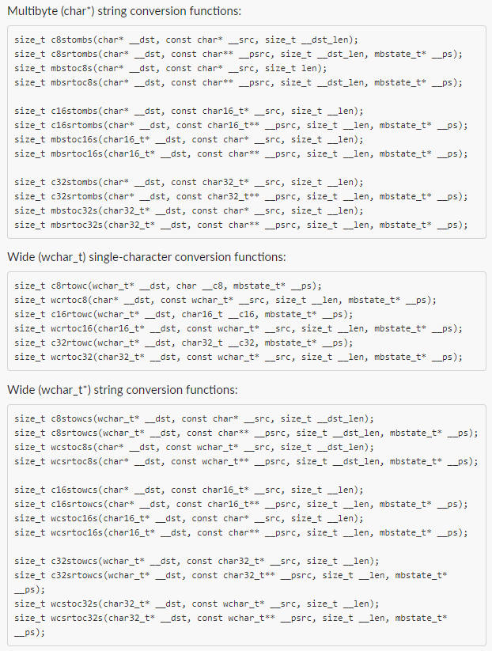
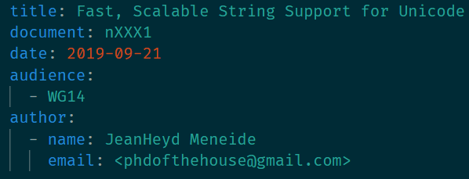
Fix: More C functions
Add:
String versions of slow, one-off character converting functions:
c[8,16,32]s[r]tombs, mbs[r]toc[8,16,32]s
And only these
Tractable: full gamut is close to 40+ extra functions

Slide 10
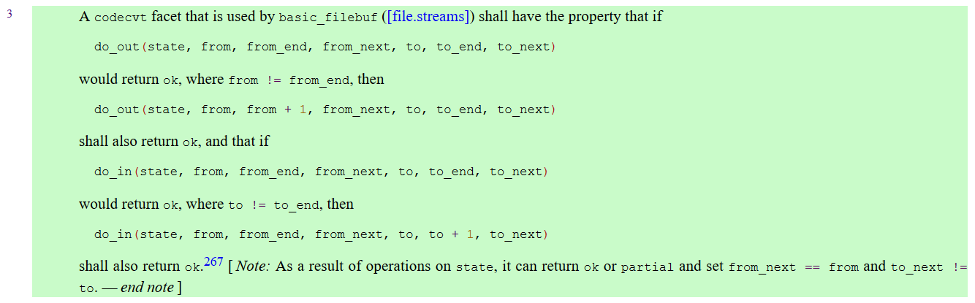
“At least C++ will—”
No.
C++ is equally unhelpful, except for UTF-8 it uses char8_t (soon)
wchar_t still sucks here: basic_filebuf is restricted to 1:1 conversion for all input and output code units [locale.codecvt.virtuals#3]
std::wstring_convert failed miserably

Slide 11
No Hotfix for <iostream>
Get rid of so-called “1:1” rule?
Okay, but…
Bigger problem:
wchar_t must be big enough to represent all codepoints (!)
picking ANYTHING except UTF32 means ruination
Therefore, even today, Windows is UCS-2 for almost all C and C++ wchar_t library functions (!!)

Slide 12
P1629 Standard Text Encoding
The C++ Fix

Slide 13
The Goal 🥅
What we are aiming for:
#include <text>
#include <iostream>
int main () {
using namespace std::literals;
std::text::u8text my_text = std::text::transcode<std::text::utf8>(“안녕하세요 👋”sv);
std::cout << my_text << std::endl; // prints 안녕하세요 👋 to a capable console
std::cout << std::hex;
for (const auto& maybe_cp : my_text ) {
std::cout << static_cast<uint32_t>(*maybe_cp) << “ “;
}
// 0000c548 0000b155 0000d558 0000c138 0000c694 00000020 0001f44b
}

Slide 14
Keep this dream in mind…

Slide 15

Digging Deep
Or: “How do we get to there, from here?”

Slide 16
Foundation: encoding objects
Encoding is a concept that a class can satisfy
It has some required (and optional) operations
Serves as the foundational building block
Encodes and decodes one code point at a time
Member types and static member variables to dictate some useful defaults

Slide 17
An example encoding object
struct utf8 {
using state = __text_detail::__empty_state; using code_unit = char8_t; using code_point = unicode_code_point; using is_decode_injective = std::true_type; using is_encode_injective = std::true_type; template <typename __InputRange, typename __OutputRange, typename __ErrorHandler> static constexpr auto encode(__InputRange&& __input, __OutputRange&& __output, state& __s, __ErrorHandler&& __error_handler); template <typename __InputRange, typename __OutputRange, typename __ErrorHandler> static constexpr auto decode(__InputRange&& __input, __OutputRange&& __output, state& __s, __ErrorHandler&& __error_handler); };

Slide 18
3-speed approach
Slowest Path (round-trip transcoding, non-eager)
Faster Path (direct transcoding, no round-tripping, lazy)
Fastest Path (bulk processing, eager consumption)

Slide 19
Slowest Path
Encoded Single Input
Decode → Unicode Code Point
Unicode Code Point → Encode
Encoded Single Output
Works for Everything™
Ideal for disparate encodings
SHIFT-JIS to GB18030
Roundtrips through Unicode
Converts one codepoint at a time

Slide 20
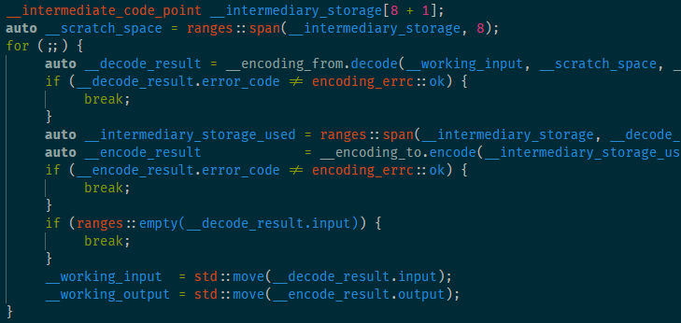
Slowest Path: Explicit Encode, Explicit Decode
Roundtrip from encoding to decoding through common code point
One-by-one encoding and checking
Safe, scalable

Slide 21
Slowest Path: lazy transcode_view 🐢
transcode_view wraps a wrap a range
takes encoding objects as template parameters (From, To)
Round-trip converts
using namespace std::text; transcode_view<std::u16string_view, utf16, utf32> lazy( u“🐶 woof!”); for (const auto& utf32_cp : lazy_view) { char32_t u32_data = *utf32_cp; // do as you wish }

Slide 22
Faster Path
Encoded Single Input
Direct Transcode
Encoded Single output
Specific to a direction and a pair of encodings
Ideal for encodings where we know there are fast conversion (utf8 ←→ ut32, utf16 ←→ utf32)
Converts directly without necessarily going to a code point
One at a time conversion still

Slide 23
Faster Path: transcoding view/iterators 🐇🏃‍♀️
Mostly invisible to user:
transcode_view customization points underneath do direct one-by-one conversion work
Speed up conversion by directly transcoding from one encoding scheme to another
Faster, but not fastest: see Zach Laine’s work in Boost.Text and June 26th SG16 discussion
https://github.com/sg16-unicode/sg16-meetings#june-26th-2019
using namespace std::text; transcode_view<std::u16string_view, utf8, utf32> lazy( u8“🐶 woof!”); for (const auto& utf32_cp : lazy_view) { char32_t u32_data = *utf32_cp; // do as you wish }

Slide 24
Fastest Path
Encoded Input
Direct Transcode
Encoded Output
Specific to a direction and a pair of encodings
Bulk transcode converts directly without necessarily going to a code point
Bulk conversion (SIMD, etc.)
Typically done on ContiguousRanges

Slide 25
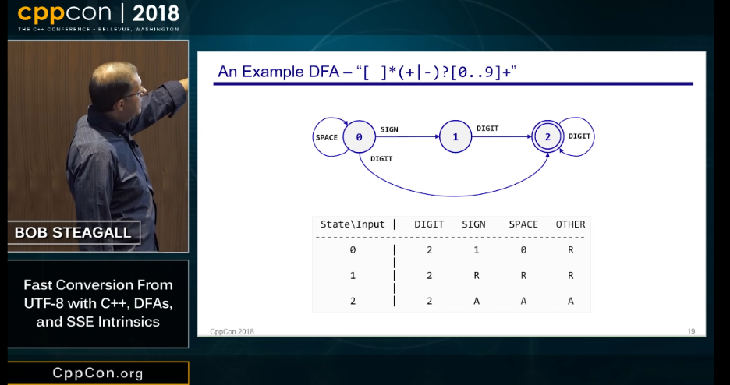
Fastest Path: eager function 🏎️
Absolute fastest path
Uses a free function to convert as much as possible
Allows optimizations à la Bob Steagall: https://www.youtube.com/watch?v=5FQ87-Ecb-A
using namespace std::text; u8text my_utf8_string = transcode<utf8>(U“𐌼𐌰𐌲 𐌲𐌻𐌴𐍃 𐌹̈𐍄𐌰𐌽, 𐌽𐌹 𐌼𐌹𐍃 𐍅𐌿 𐌽𐌳𐌰𐌽 𐌱𐍂𐌹𐌲𐌲𐌹𐌸.”);

Slide 26
Customization
People outside the standard will have encodings and encoding conversion pairs they care about
Planned to have std::text::transcode, std::text::encode, and std::text::decode be customization points (Niebloids or Partial Struct Specializations)
Takes pressure of std implementers to have to provide amazing QoI at the very beginning
Users can substitute in their proprietary converts for the 90% cases they care about
The rest will still work through the “Faster” and “Slower” paths

Slide 27
Implementation
Work has begun
https://github.com/ThePhD/phd/tree/master/include/phd/text
Need to go from working Proof of Concept to real implementation
Seeking grant to do work over the end of the Summer and for the Fall Semester as a Thesis Course

Slide 28



Join us online, at the mailing list, in our repositories, open teleconferences, and more:
https://github.com/sg16-unicode/sg16
Support my work:
https://github.com/users/ThePhD/sponsorship https://thephd.github.io/support/

